Slide 1
Compact Model Representation for 3D Reconstruction
Supplementary Material
Jhony K. Pontes, Chen Kong, Anders Eriksson, Clinton Fookes, Sridha Sridharan, and Simon Lucey
International Conference on 3D Vision 2017

Slide 2
4. Experiments 4.1. Creating the Graph

Slide 3
Source
#vertices: 20,647
#edges: 75,830
Target
#vertices: 5,982
#edges: 23,936

Slide 4
Warping the Source (in red) to fit the Target (in blue) by nonrigid ICP as in [12]
Click Play
[12] C. Kong, C-H. Lin and S. Lucey, Using Locally Corresponding CAD Models for Dense 3D Reconstructions from a Single Image, CVPR 2017.

Slide 5
Deforming the Source (in red) to fit the Target (in blue) by FFD
Click Play

Slide 6
Warping the Source (in red) to the fit the deformed (by FFD) Target (in blue) by nonrigid ICP
Click Play

Slide 7
Target
Warped model [12]
Our warped model
[12] C. Kong, C-H. Lin and S. Lucey, Using Locally Corresponding CAD Models for Dense 3D Reconstructions from a Single Image, CVPR 2017.

Slide 8
4. Experiments 4.2. Single Image 3D Reconstruction

Slide 9
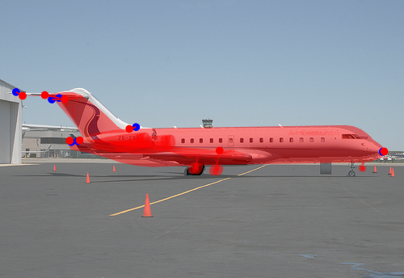
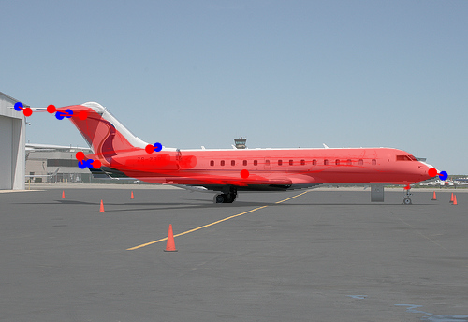
FFD - Anchor Registration
Silhouette Fitting

Slide 10
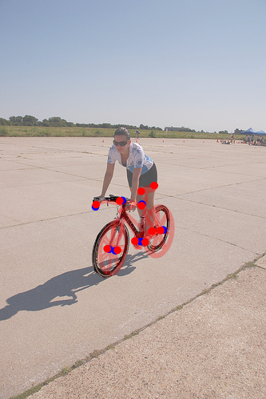
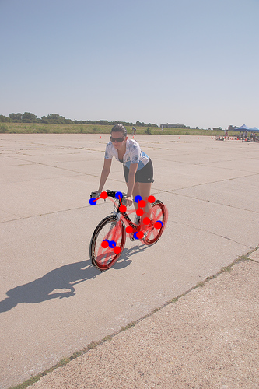
FFD - Anchor Registration
Silhouette Fitting

Slide 11
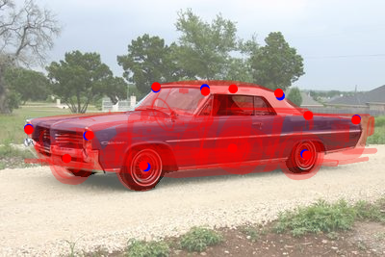
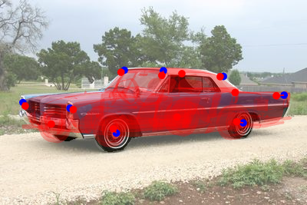
FFD - Anchor Registration
Silhouette Fitting

Slide 12
FFD - Anchor Registration
Silhouette Fitting
The car is squeezed a little bit to fit the silhouette

Slide 13
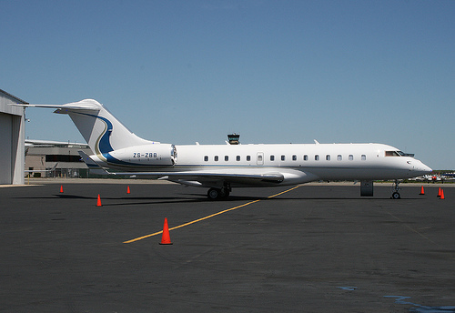
Kong et al. [12]
Ours
GT
[12] C. Kong, C-H. Lin and S. Lucey, Using Locally Corresponding CAD Models for Dense 3D Reconstructions from a Single Image, CVPR 2017.

Slide 14
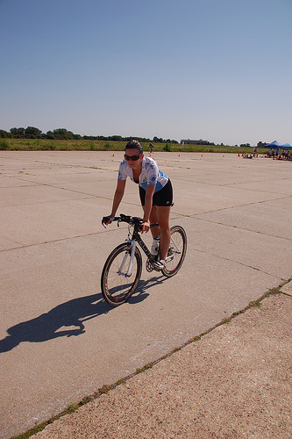
Kong et al. [12]
Ours
GT
[12] C. Kong, C-H. Lin and S. Lucey, Using Locally Corresponding CAD Models for Dense 3D Reconstructions from a Single Image, CVPR 2017.

Slide 15
Kong et al. [12]
Ours
GT
[12] C. Kong, C-H. Lin and S. Lucey, Using Locally Corresponding CAD Models for Dense 3D Reconstructions from a Single Image, CVPR 2017.

